Slide 1
Chapter 6 Methods: A Deeper Look

Slide 2
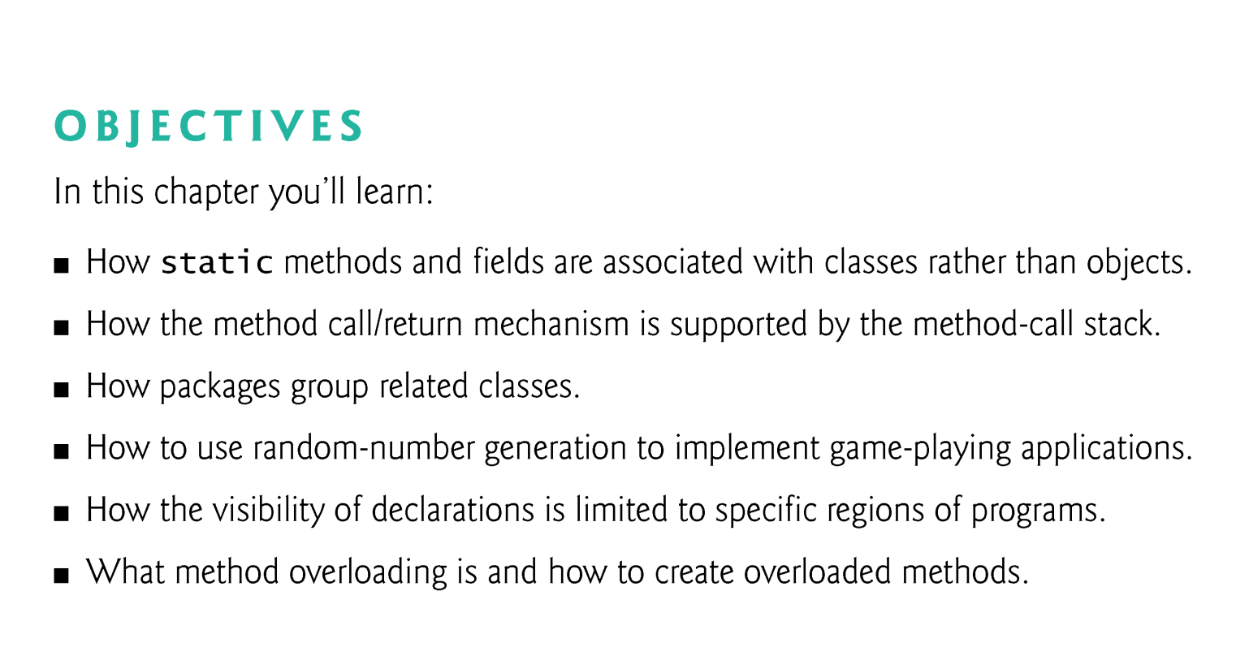

Slide 3
6.1 Introduction
Best way to develop and maintain a large program is to construct it from small, simple pieces, or modules.
divide and conquer.

Slide 4
6.2 Program Modules in Java
Java programs combine new methods and classes that you write with predefined methods and classes available in the Java Application Programming Interface and in other class libraries.
Related classes are typically grouped into packages so that they can be imported into programs and reused.
You’ll learn how to group your own classes into packages in Chapter 8.

Slide 5
6.2 Program Modules in Java (Cont.)
Methods help you modularize a program by separating its tasks into self-contained units.
Statements in method bodies
Written only once
Hidden from other methods
Can be reused from several locations in a program
Divide-and-conquer approach
Constructing programs from small, simple pieces
Software reusability
Use existing methods as building blocks to create new pro-grams.
Dividing a program into meaningful methods makes the program easier to debug and maintain.

Slide 6
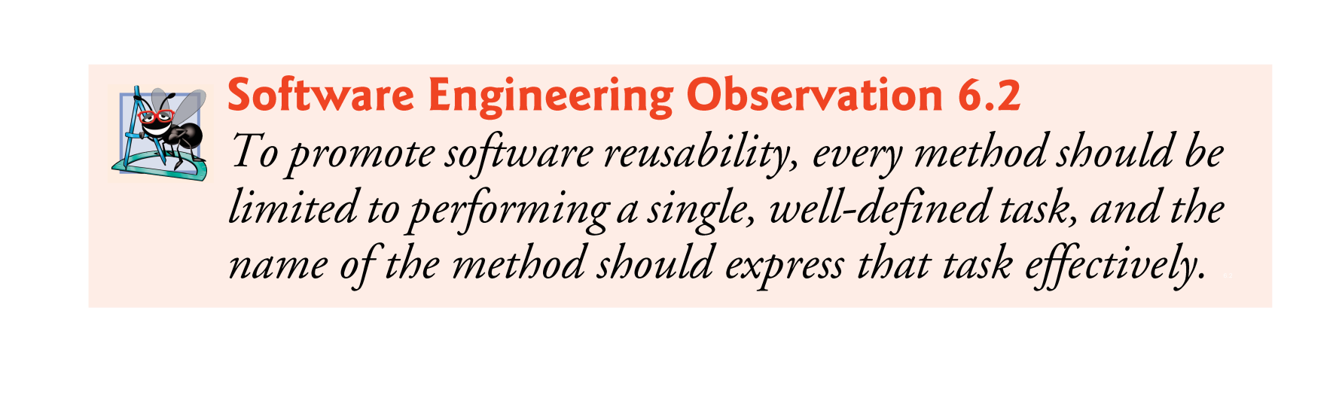

Slide 7
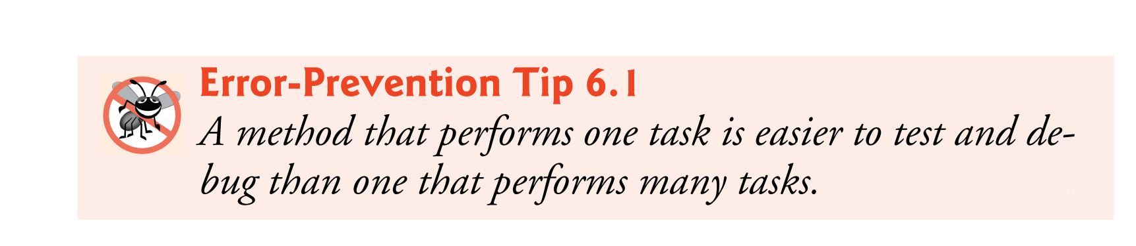

Slide 8
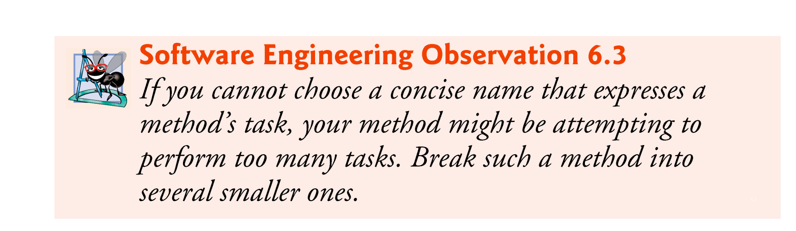

Slide 9
6.2 Program Modules in Java (Cont.)
Hierarchical form of management (Fig. 6.1).
A boss (the caller) asks a worker (the called method) to perform a task and report back (return) the results after completing the task.
The boss method does not know how the worker method performs its designated tasks.
The worker may also call other worker methods, unbeknown to the boss.
“Hiding” of implementation details promotes good software engineering.

Slide 10
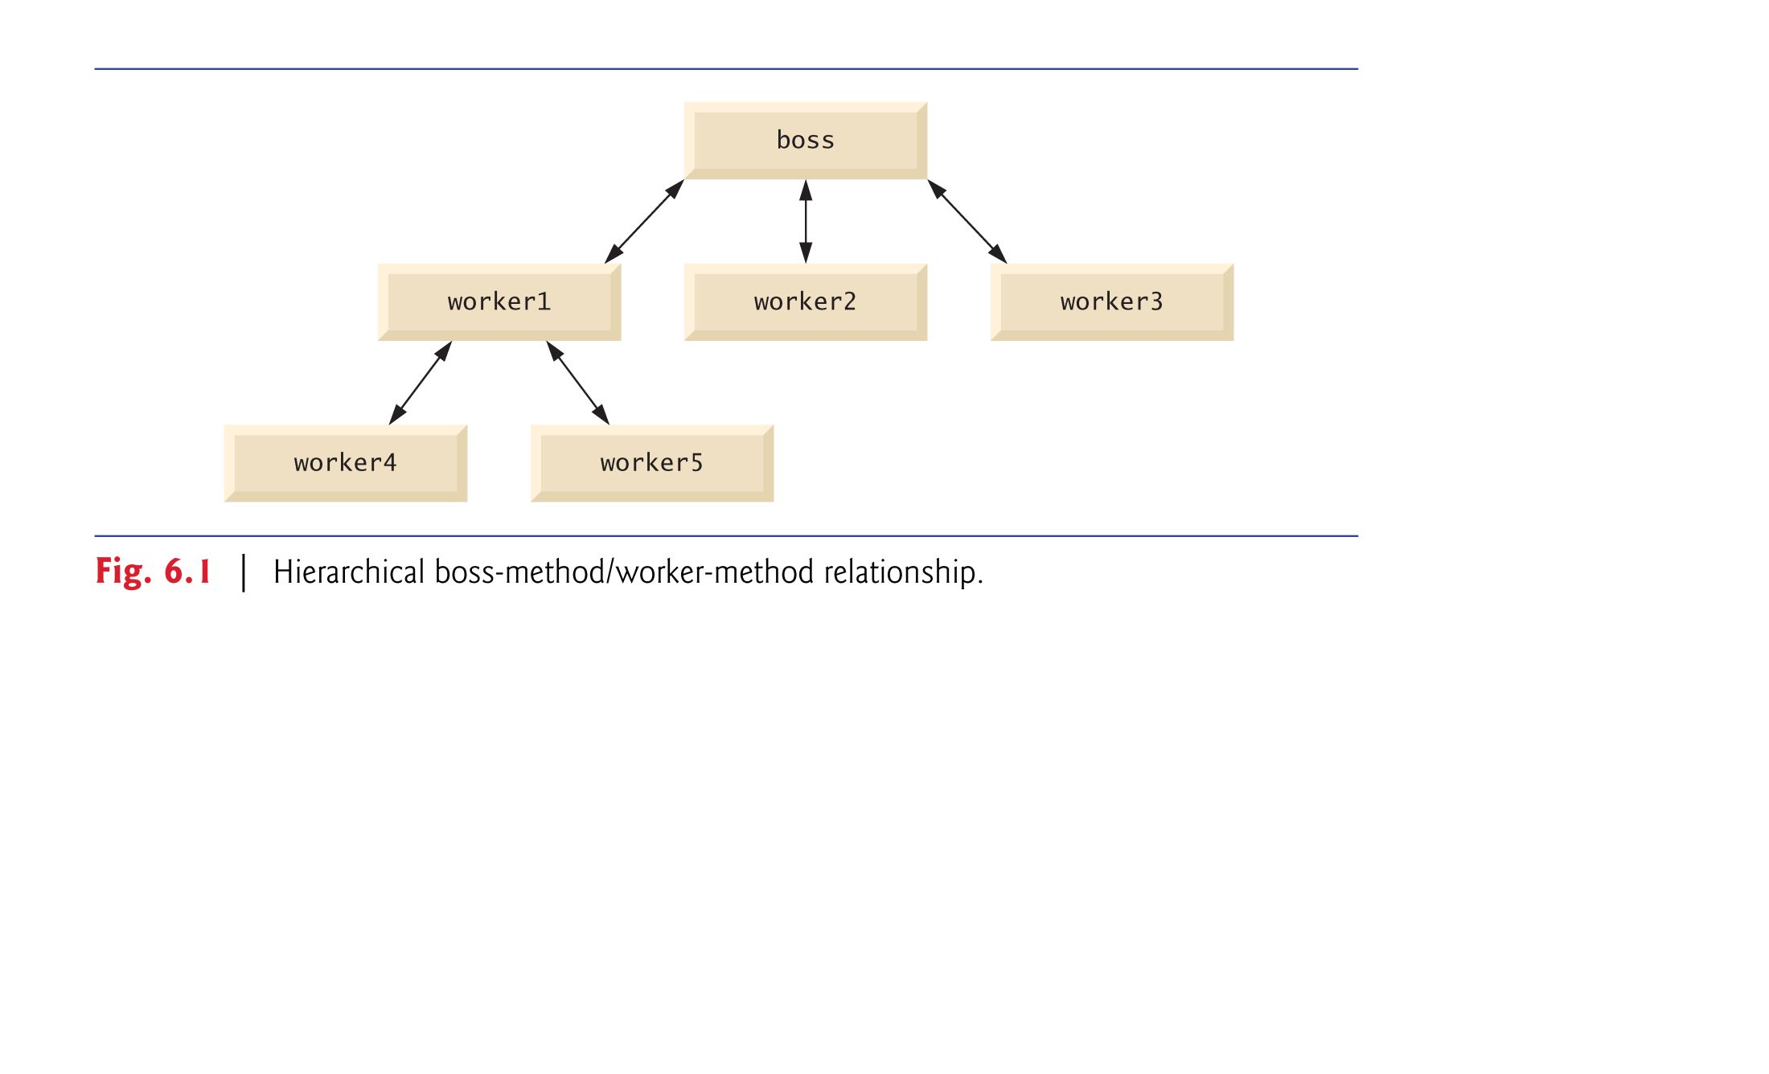

Slide 11
6.3 static Methods, static Fields and Class Math
Sometimes a method performs a task that does not depend on the contents of any object.
Applies to the class in which it’s declared as a whole
Known as a static method or a class method
To declare a method as static, place the keyword static before the return type in the method’s declaration.
Calling a static method
ClassName.methodName( arguments )
Class Math provides a collection of static methods that enable you to perform common mathematical calculations.
Method arguments may be constants, variables or expressions.

Slide 12
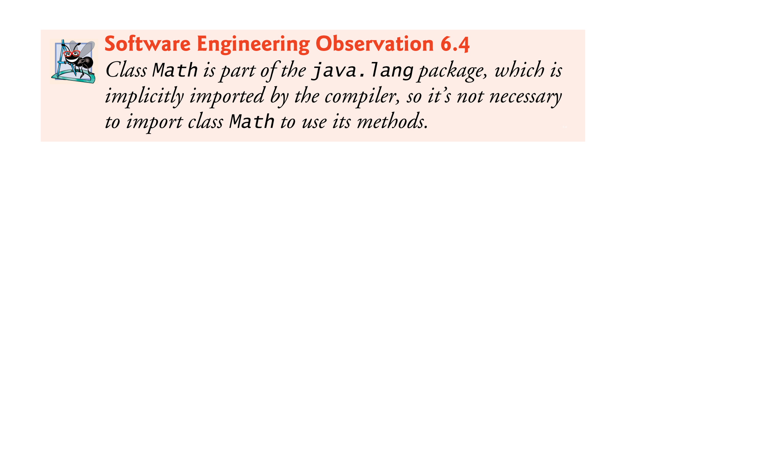

Slide 13
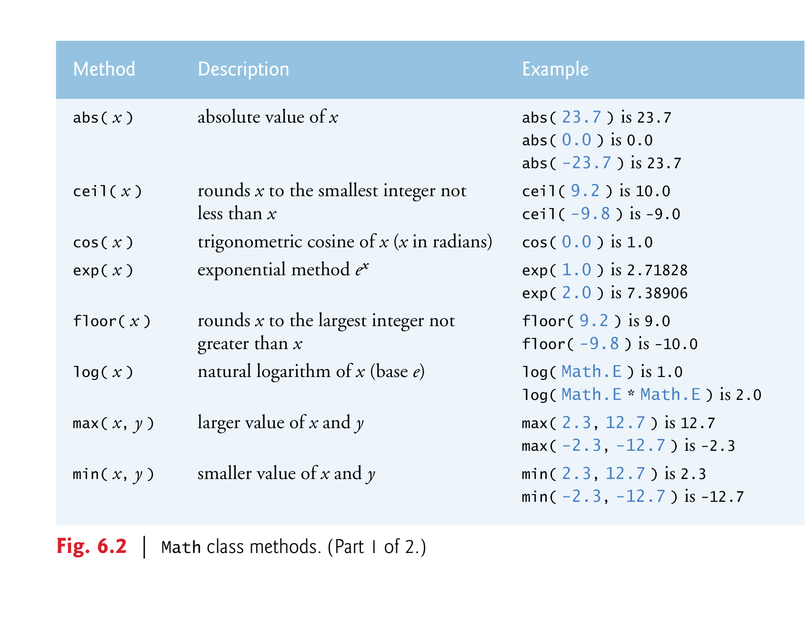

Slide 14
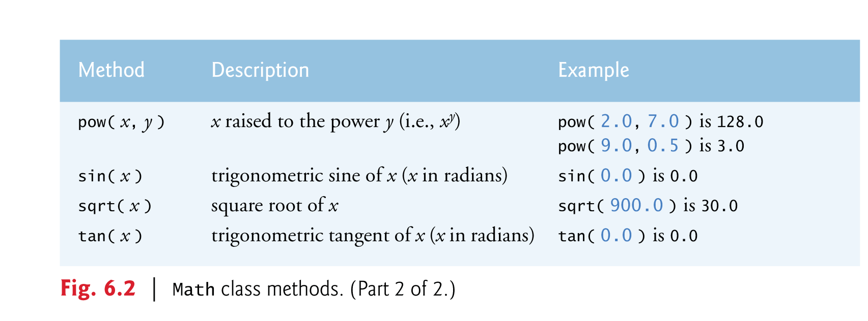

Slide 15
6.3 static Methods, static Fields and Class Math (Cont.)
Math fields for common mathematical constants
Math.PI (3.141592653589793)
Math.E (2.718281828459045)
Declared in class Math with the modifiers public, final and static
public allows you to use these fields in your own classes.
A field declared with keyword final is constant—its value cannot change after the field is initialized.
PI and E are declared final because their values never change.

Slide 16
6.3 static Methods, static Fields and Class Math (Cont.)
A field that represents an attribute is also known as an instance variable—each object (instance) of the class has a separate instance of the variable in memory.
Fields for which each object of a class does not have a separate instance of the field are declared static and are also known as class variables.
All objects of a class containing static fields share one copy of those fields.
Together the class variables (i.e., static variables) and instance variables represent the fields of a class.

Slide 17
6.3 static Methods, static Fields and Class Math (Cont.)
Why is method main declared static?
The JVM attempts to invoke the main method of the class you specify—when no objects of the class have been created.
Declaring main as static allows the JVM to invoke main without creating an instance of the class.

Slide 18
6.4 Declaring Methods with Multiple Parameters
Multiple parameters are specified as a comma-separated list.
There must be one argument in the method call for each parameter (sometimes called a formal parameter) in the method declaration.
Each argument must be consistent with the type of the corresponding parameter.

Slide 19
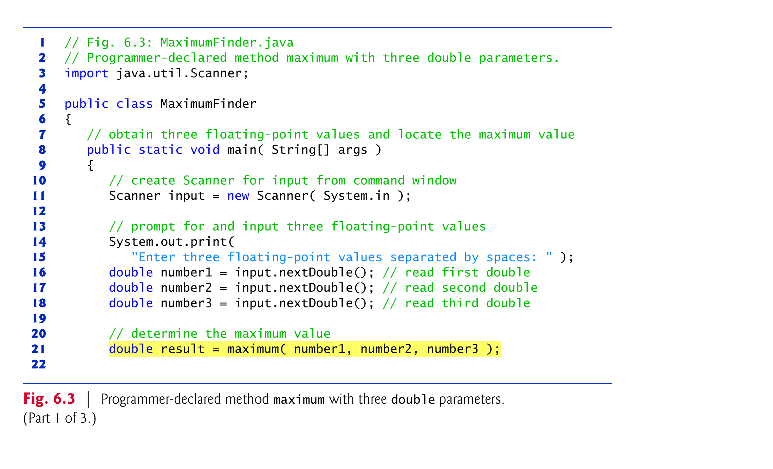

Slide 20
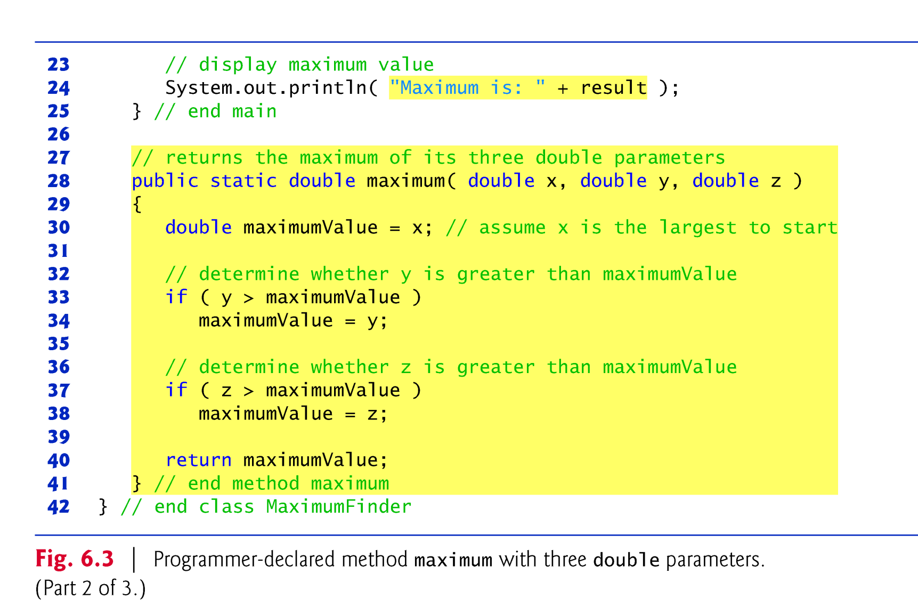

Slide 21
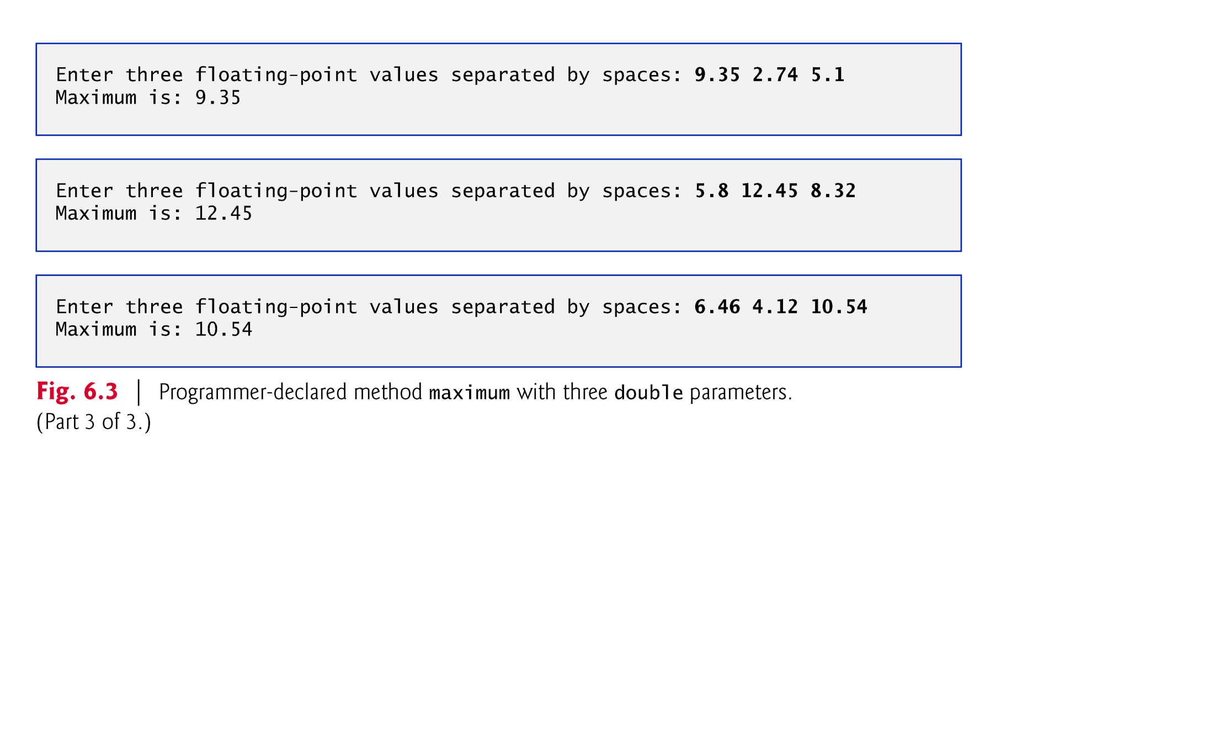

Slide 22


Slide 23


Slide 24
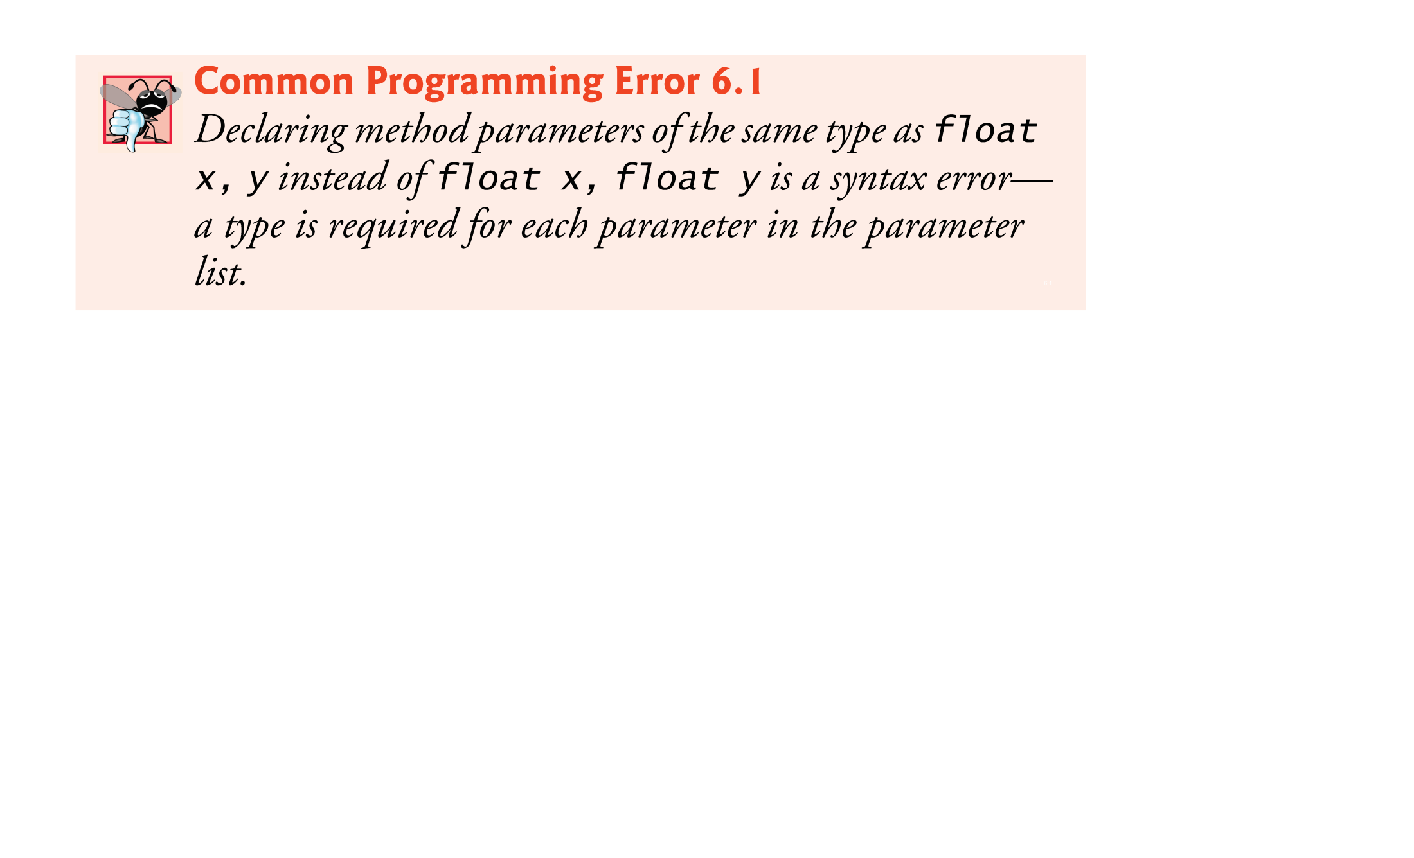

Slide 25
6.4 Declaring Methods with Multiple Parameters (Cont.)
Implementing method maximum by reusing method Math.max
Two calls to Math.max, as follows:
return Math.max( x, Math.max( y, z ) );
The first specifies arguments x and Math.max( y, z ).
Before any method can be called, its arguments must be evaluated to determine their values.
If an argument is a method call, the method call must be performed to determine its return value.
The result of the first call is passed as the second argument to the other call, which returns the larger of its two arguments.

Slide 26
6.4 Declaring Methods with Multiple Parameters (Cont.)
String concatenation
Assemble String objects into larger strings with operators + or +=.
When both operands of operator + are Strings, operator + creates a new String object
Every primitive value and object in Java has a String representation.
When one of the + operator’s operands is a String, the other is converted to a String, then the two are concatenated.
If a boolean is concatenated with a String, the boolean is converted to the String "true" or "false".
All objects have a toString method that returns a String representation of the object.

Slide 27
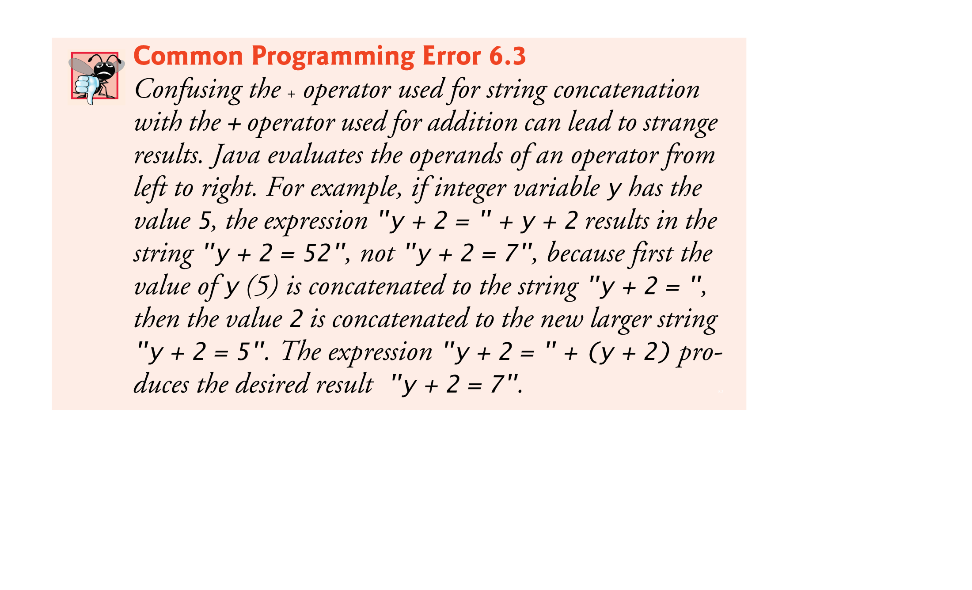

Slide 28
6.5 Notes on Declaring and Using Methods
Three ways to call a method:
Using a method name by itself to call another method of the same class
Using a variable that contains a reference to an object, followed by a dot (.) and the method name to call a method of the referenced object
Using the class name and a dot (.) to call a static method of a class

Slide 29
6.5 Notes on Declaring and Using Methods (Cont.)
A non-static method can call any method of the same class directly and can manipulate any of the class’s fields directly.
A static method can call only other static methods of the same class directly and can manipulate only static fields in the same class directly.
To access the class’s non-static members, a static method must use a reference to an object of the class.

Slide 30
6.5 Notes on Declaring and Using Methods (Cont.)
Three ways to return control to the statement that calls a method:
When the program flow reaches the method-ending right brace
When the following statement executes
return;
When the method returns a result with a statement like
return expression;

Slide 31


Slide 32


Slide 33
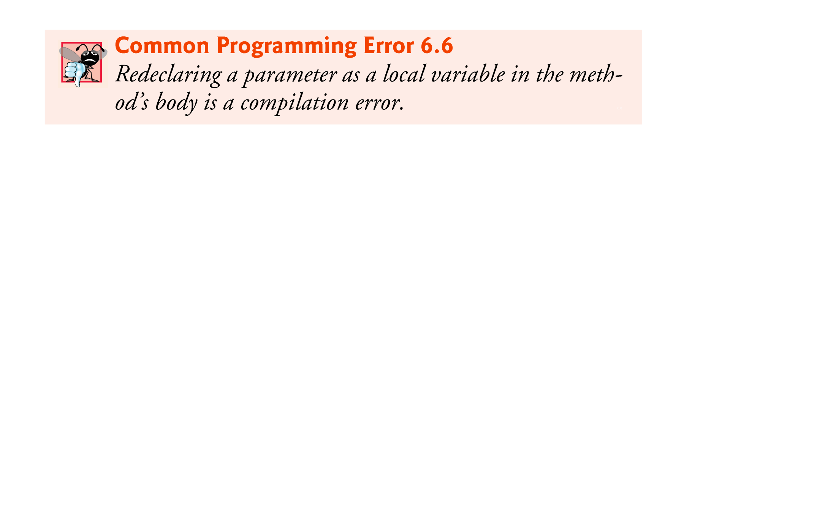

Slide 34
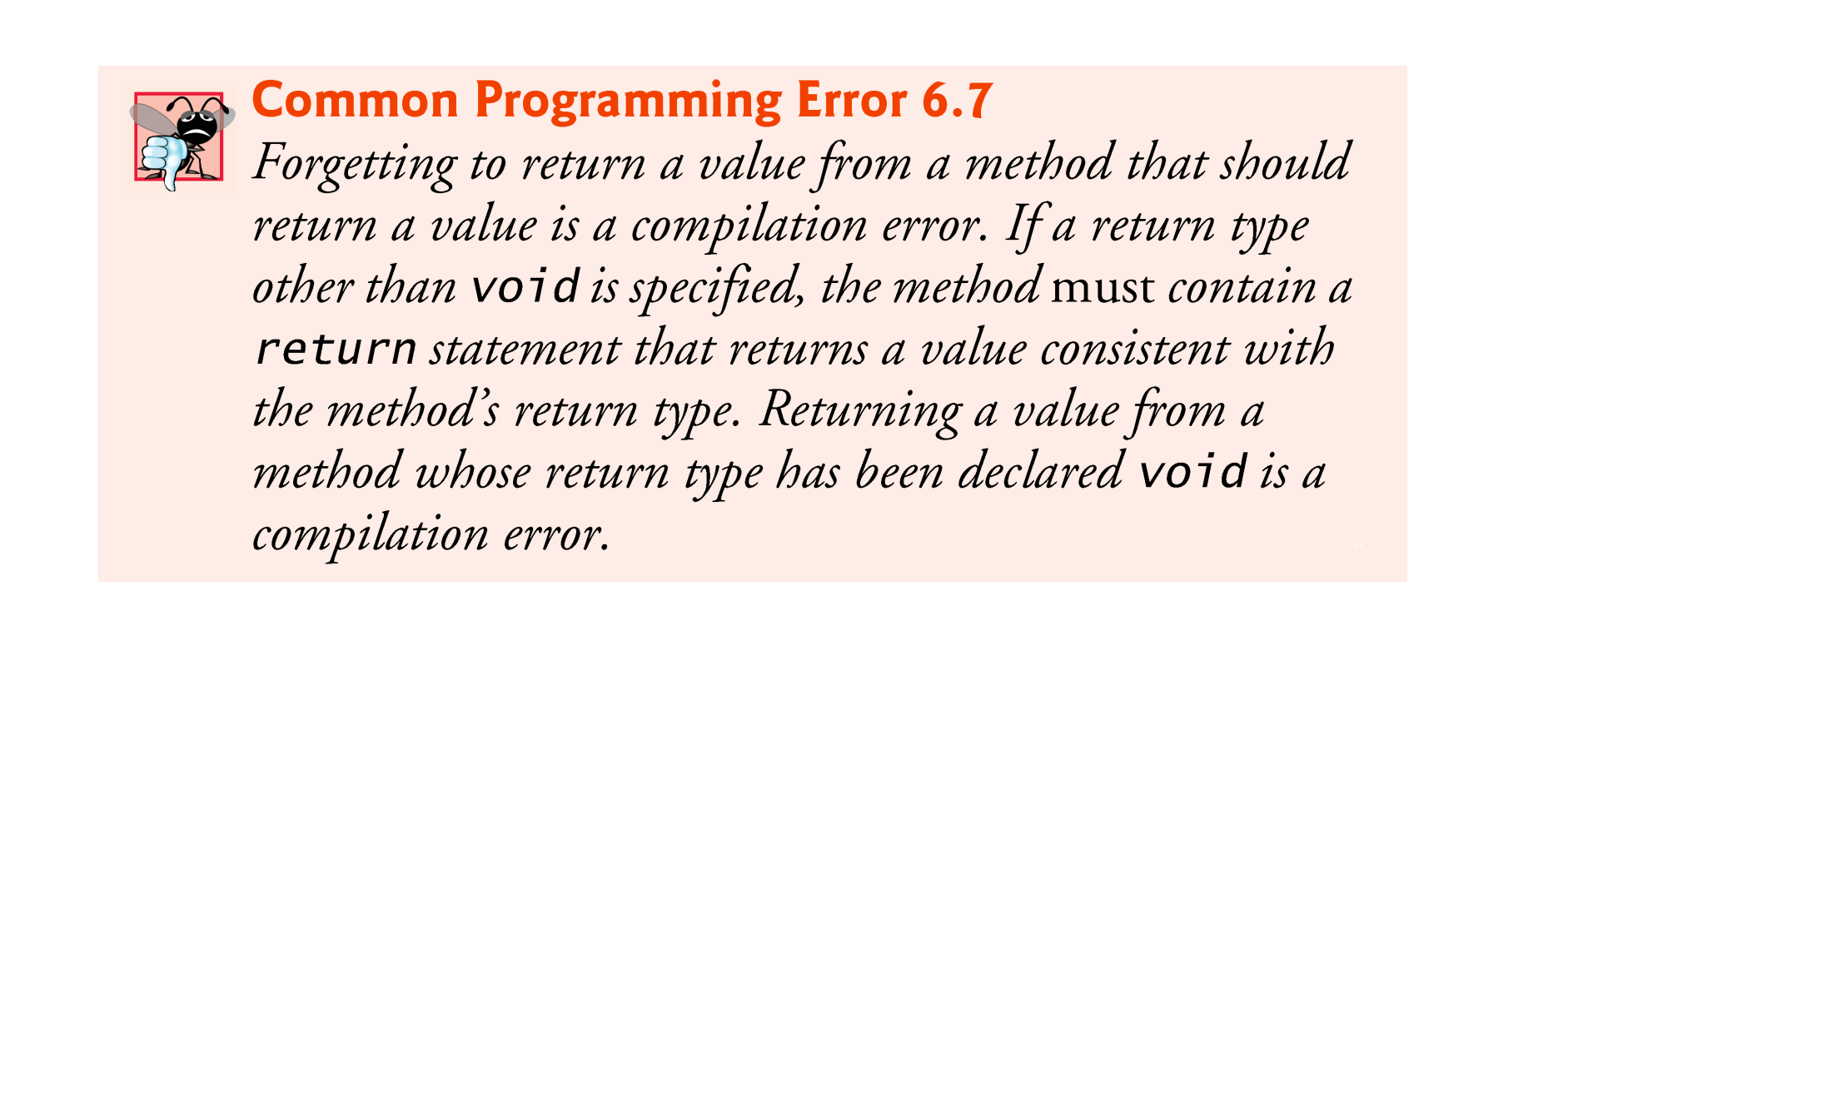

Slide 35
6.6 Method-Call Stack and Activation Records
Stack data structure
Analogous to a pile of dishes
A dish is placed on the pile at the top (referred to as pushing the dish onto the stack).
A dish is removed from the pile from the top (referred to as popping the dish off the stack).
Last-in, first-out (LIFO) data structures
The last item pushed (inserted) on the stack is the first item popped (removed) from the stack.

Slide 36
6.7 Argument Promotion and Casting
Argument promotion
Converting an argument’s value, if possible, to the type that the method expects to receive in its corresponding parameter.
Conversions may lead to compilation errors if Java’s promotion rules are not satisfied.
Each value is promoted to the “highest” type in the expression.
Figure 6.4 lists the primitive types and the types to which each can be promoted.

Slide 37
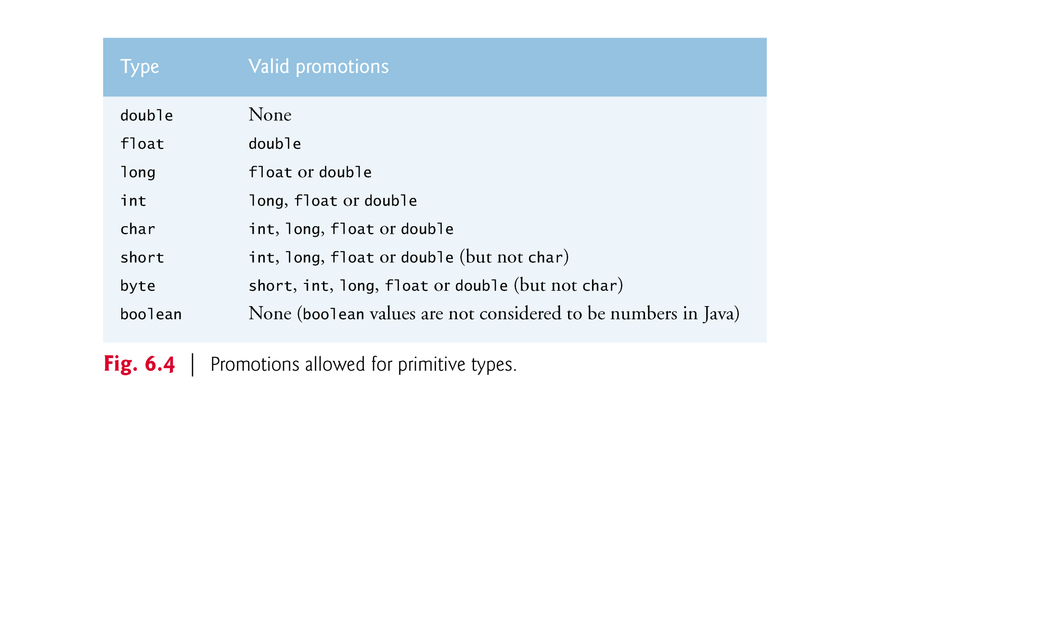

Slide 38
6.8 Java API Packages
Java contains many predefined classes that are grouped into categories of related classes called packages.
A great strength of Java is the Java API’s thousands of classes.
Some key Java API packages are described in Fig. 6.5.
Java API documentation
https://www.cs.rit.edu/usr/local/jdk/docs/api/index.html

Slide 39
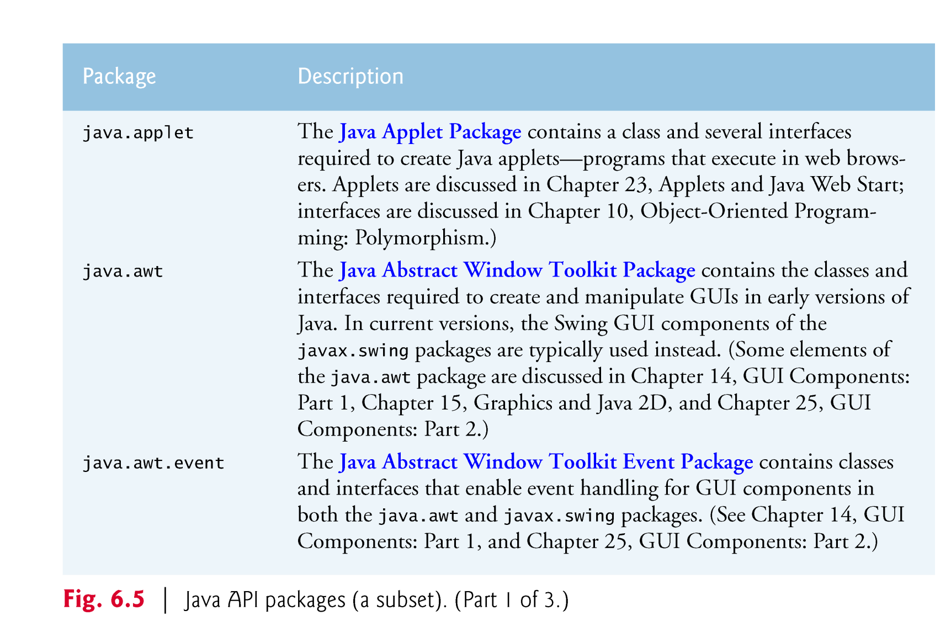

Slide 40
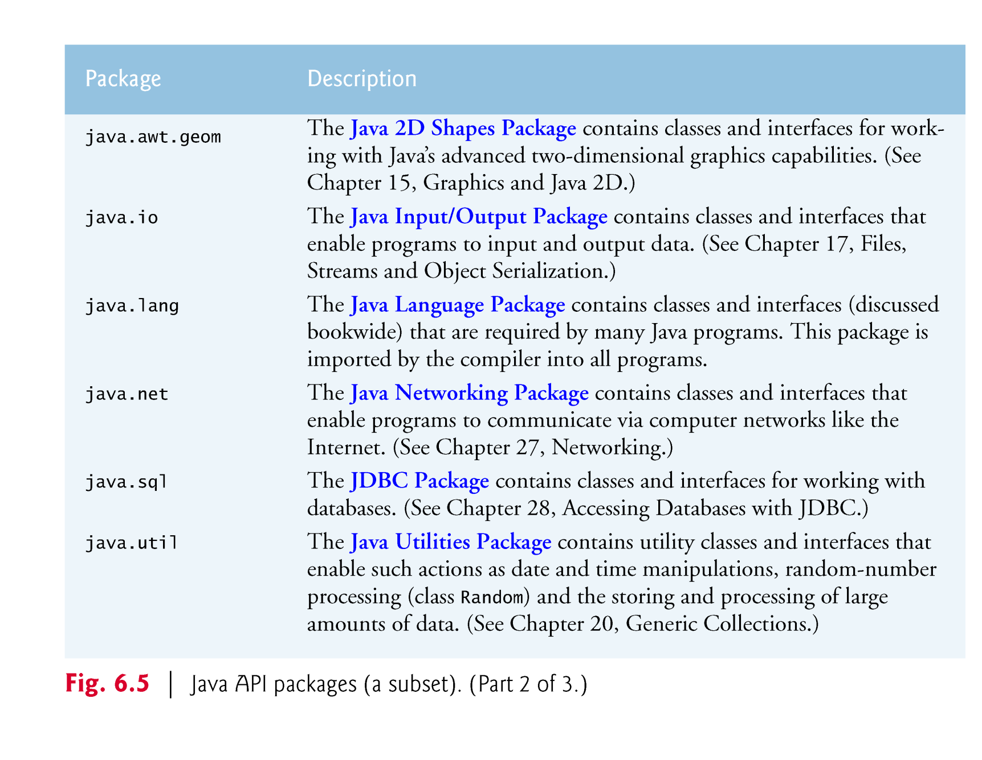

Slide 41
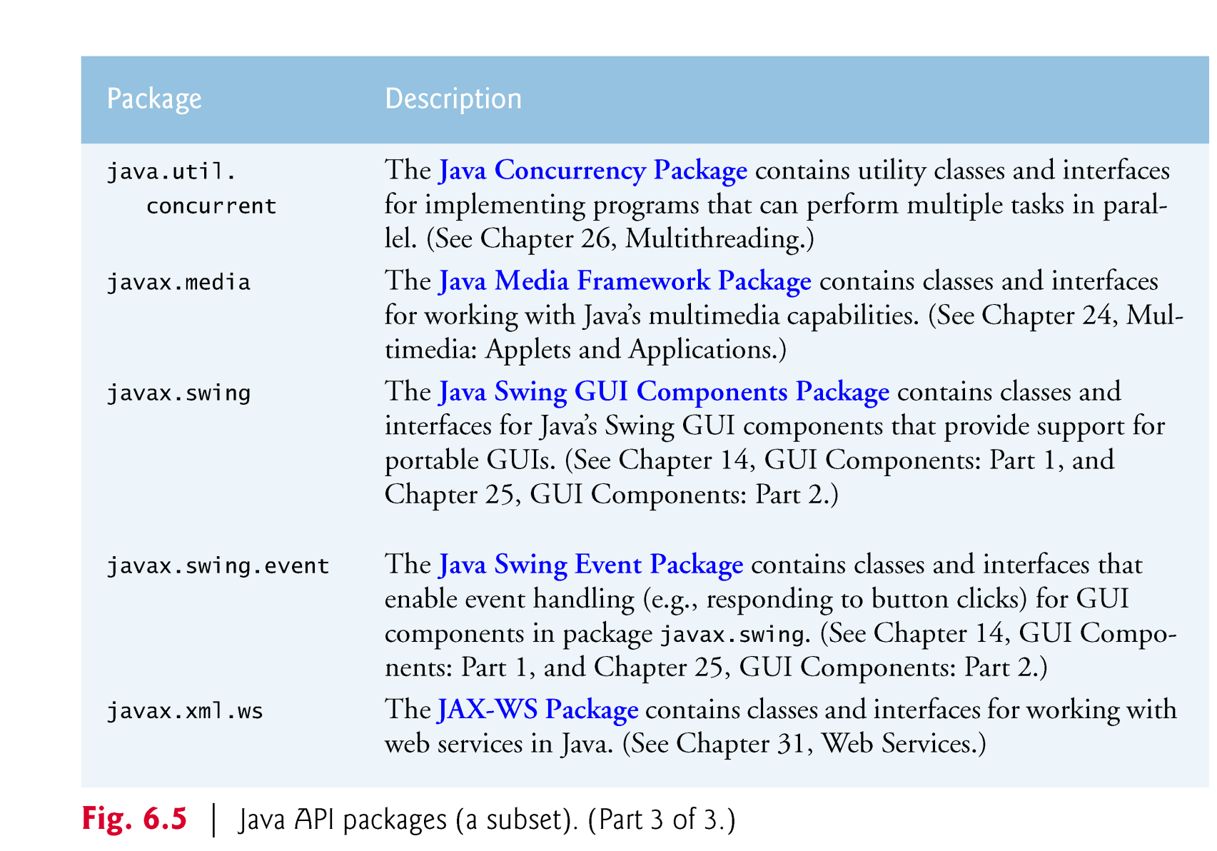

Slide 42
6.9 Case Study: Secure Random-Number Generation
Simulation and game playing
element of chance
Class SecureRandom (package java.security )
Objects of class Secure-Random can produce random boolean, byte, float, double, int, long and Gaussian values
Difference between Random and SecureRandom
Random objects produce deterministic values that could be predicted by malicious programmers.
Secure-Random objects produce nondeterministic random numbers that cannot be predicted.

Slide 43
6.9 Case Study: Secure Random-Number Generation(Cont.)
Creating a SecureRandom Object
SecureRandom randomNumbers = new SecureRandom();
Obtaining a Random int Value
int randomValue = randomNumbers.nextInt();
Changing the Rangle of value produced by nextInt (0,1)
int randomValue = randomNumbers.nextInt(2);
For more information on the SecureRandom class, see
https://www.cs.rit.edu/usr/local/jdk/docs/api/java.base/java/security/SecureRandom.html

Slide 44
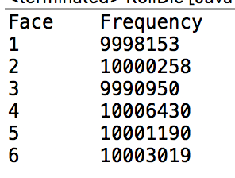
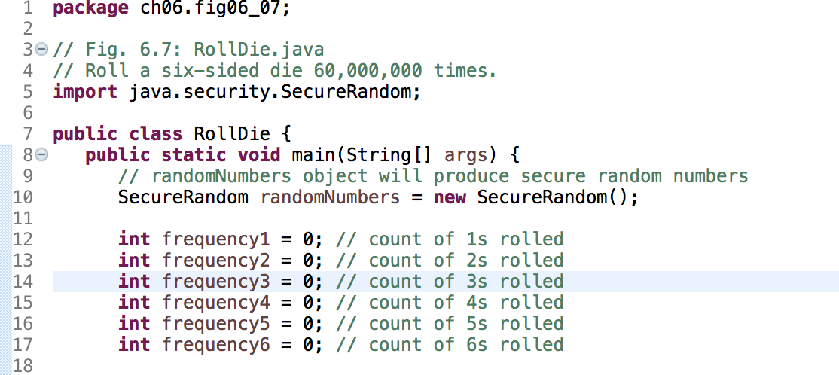
Rolling a Six-Sided Die 6,000,000 Times

Slide 45
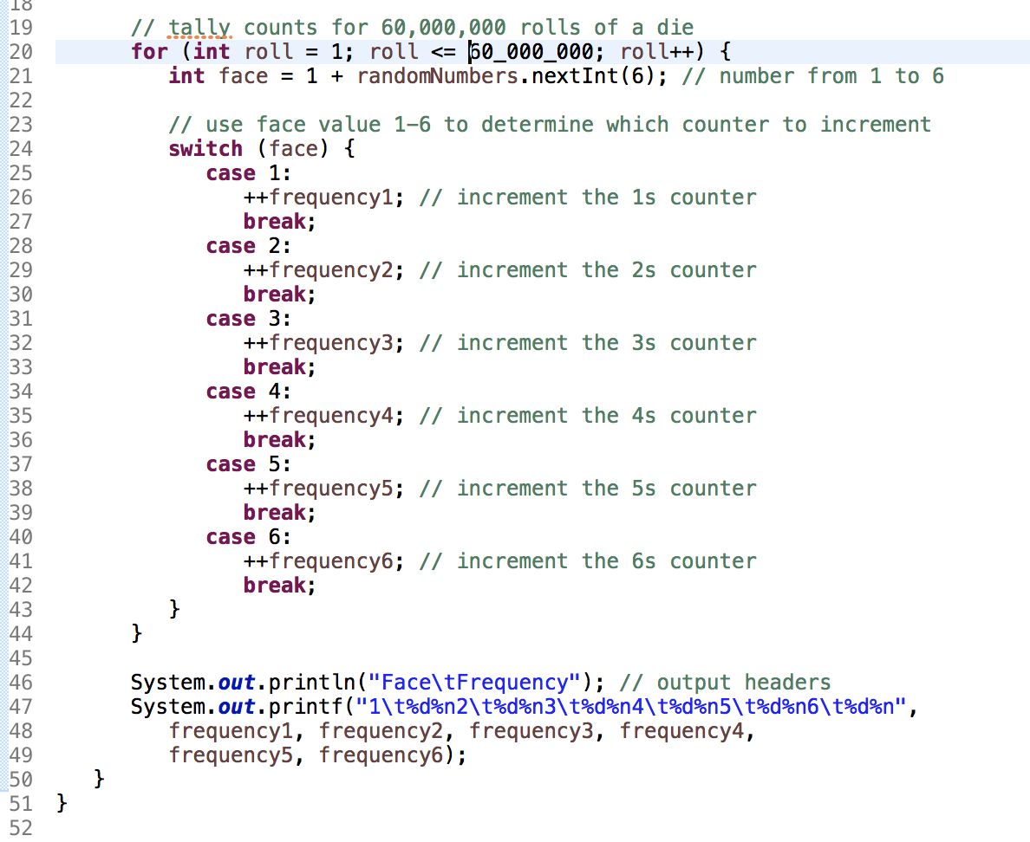

Slide 46
6.9.1 Generalized Scaling and Shifting of Random Numbers
Generalize the scaling and shifting of random numbers:
number = shiftingValue + randomNumbers.nextInt(scalingFactor);
It’s also possible to choose integers at random from sets of values other than ranges of consecutive integers:
number = shiftingValue + differenceBetweenValues * randomNumbers.nextInt( scalingFactor );

Slide 47
6.10 Case Study: A Game of Chance; Introducing enum Types
Basic rules for the dice game Craps:
You roll two dice. Each die has six faces, which contain one, two, three, four, five and six spots, respectively. After the dice have come to rest, the sum of the spots on the two upward faces is calculated. If the sum is 7 or 11 on the first throw, you win. If the sum is 2, 3 or 12 on the first throw (called “craps”), you lose (i.e., the “house” wins). If the sum is 4, 5, 6, 8, 9 or 10 on the first throw, that sum becomes your “point.” To win, you must continue rolling the dice until you “make your point” (i.e., roll that same point value). You lose by rolling a 7 before making your point.

Slide 48
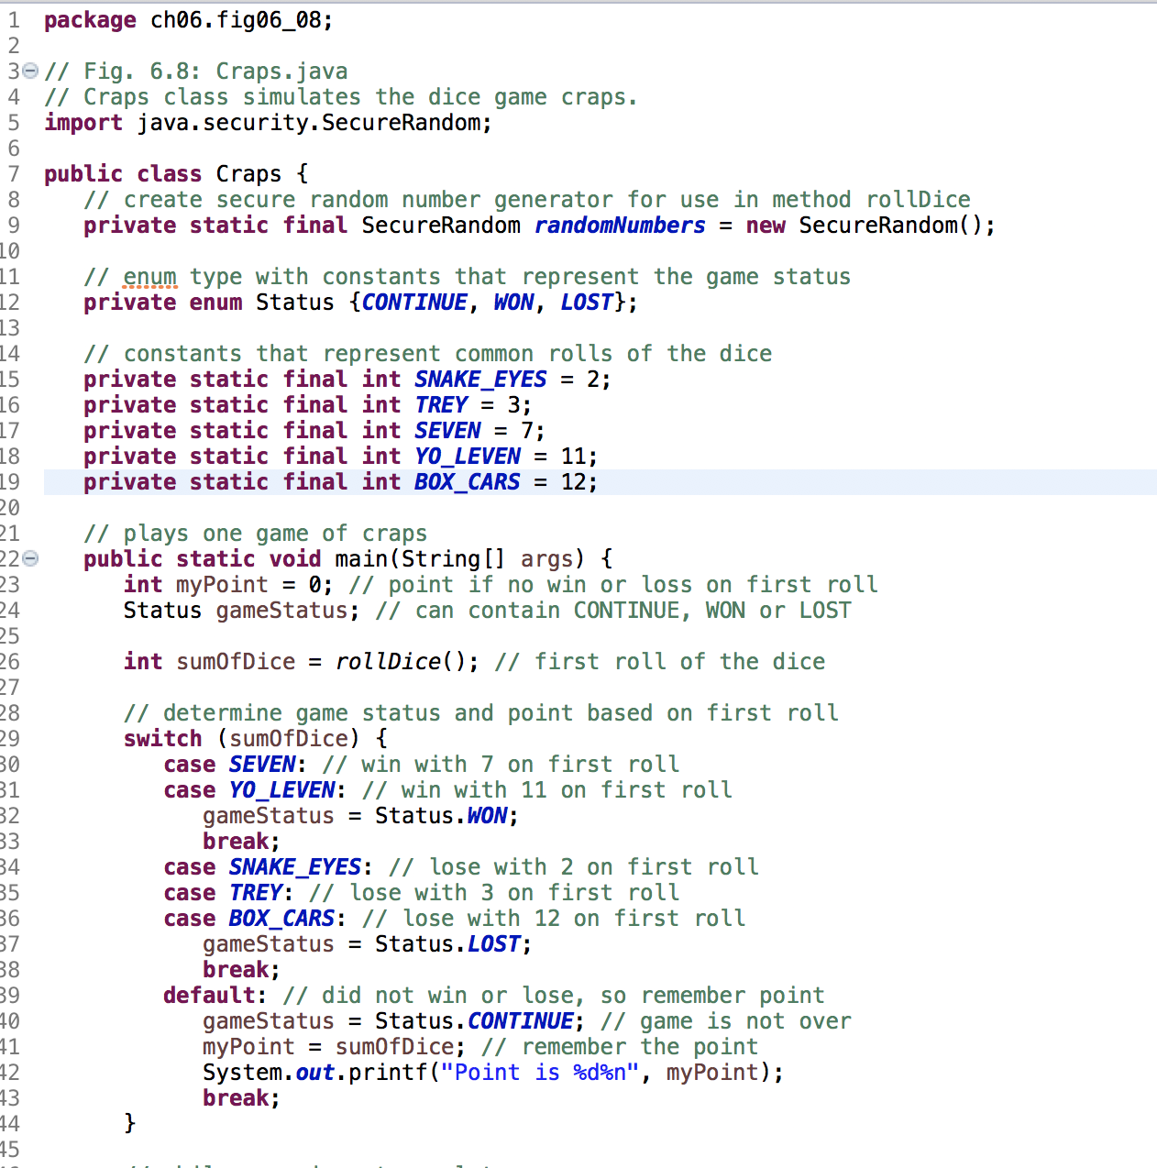

Slide 49
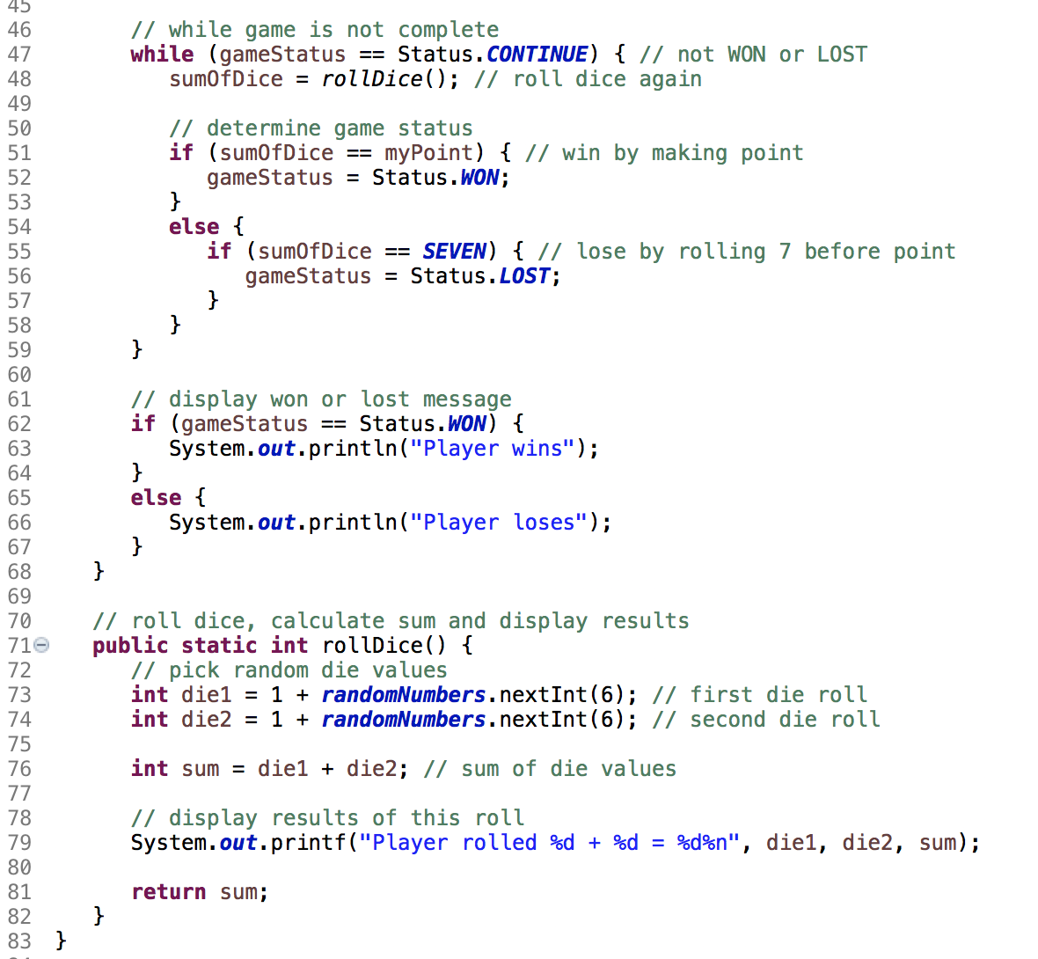

Slide 50
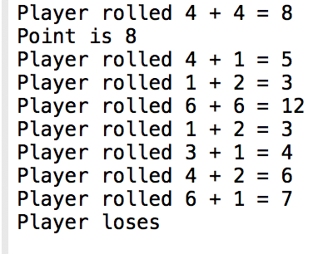

Slide 51
6.10 Case Study: A Game of Chance; Introducing enum Types (Cont.)
Notes:
Method rollDice is declared once, but it’s called from two places in main.
private static final SecureRandom randomNumbers = new SecureRandom();
declared in class but not in methods
ensure us to create one SecureRandom object that’s reused in each call to rollDice.

Slide 52
6.10 Case Study: A Game of Chance; Introducing enum Types(Cont.)
enum type Status
An enumeration in its simplest form declares a set of constants represented by identifiers.
Special kind of class that is introduced by the keyword enum and a type name.
Braces delimit an enum declaration’s body.
Inside the braces is a comma-separated list of enumeration constants, each representing a unique value.
The identifiers in an enum must be unique.
Variables of an enum type can be assigned only the constants declared in the enumeration.

Slide 53


Slide 54
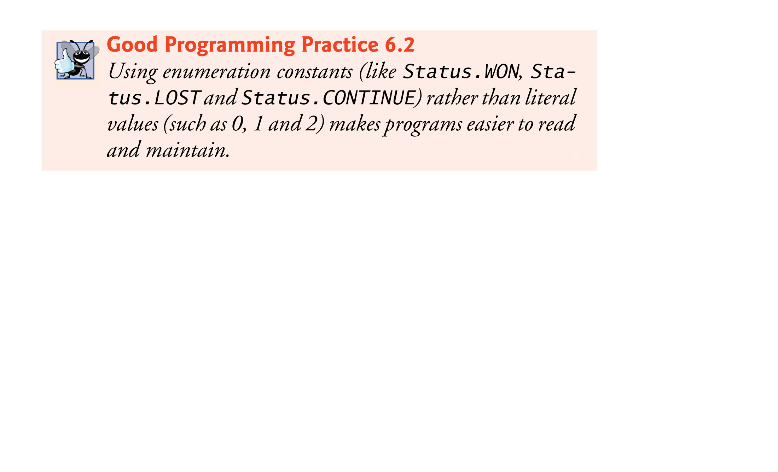

Slide 55
6.10 Case Study: A Game of Chance; Introducing enum Types(Cont.)
Why Some Constants Are Not Defined as enum Constants
Java does not allow an int to be compared to an enumeration constant.
Java does not provide an easy way to convert an int value to a particular enum constant.
Translating an int into an enum constant could be done with a separate switch statement.
This would be cumbersome and not improve the readability of the program (thus defeating the purpose of using an enum).

Slide 56
6.11 Scope of Declarations
Declarations introduce names that can be used to refer to such Java entities.
The scope of a declaration is the portion of the program that can refer to the declared entity by its name.
Such an entity is said to be “in scope” for that portion of the program.

Slide 57
6.11 Scope of Declarations (Cont.)
Basic scope rules:
The scope of a parameter declaration is the body of the method in which the declaration appears.
The scope of a local-variable declaration is from the point at which the declaration appears to the end of that block.
The scope of a local-variable declaration that appears in the initialization section of a for statement’s header is the body of the for statement and the other expressions in the header.
A method or field’s scope is the entire body of the class.
Any block may contain variable declarations.
If a local variable or parameter in a method has the same name as a field of the class, the field is “hidden” until the block terminates execution—this is called shadowing.

Slide 58
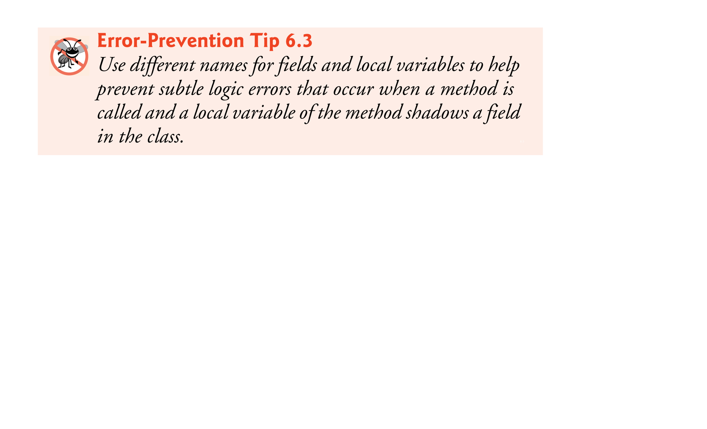

Slide 59
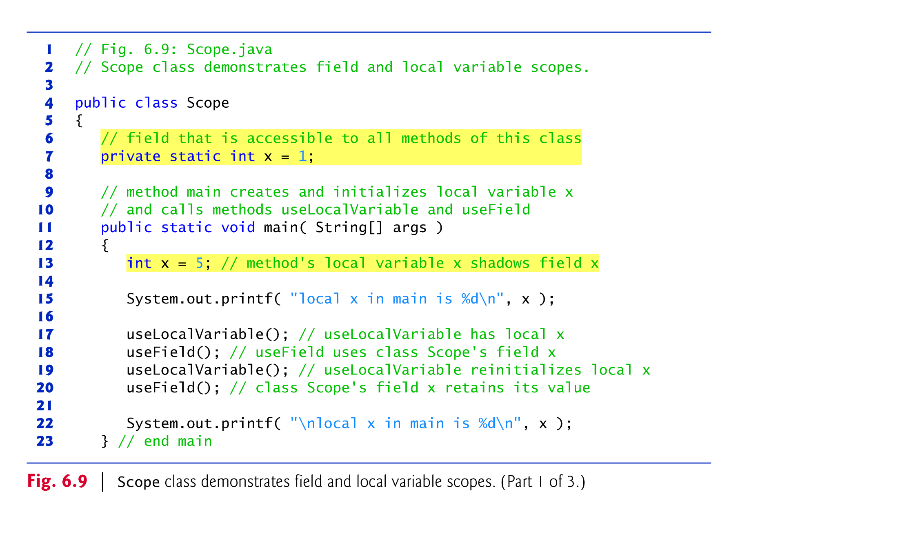

Slide 60
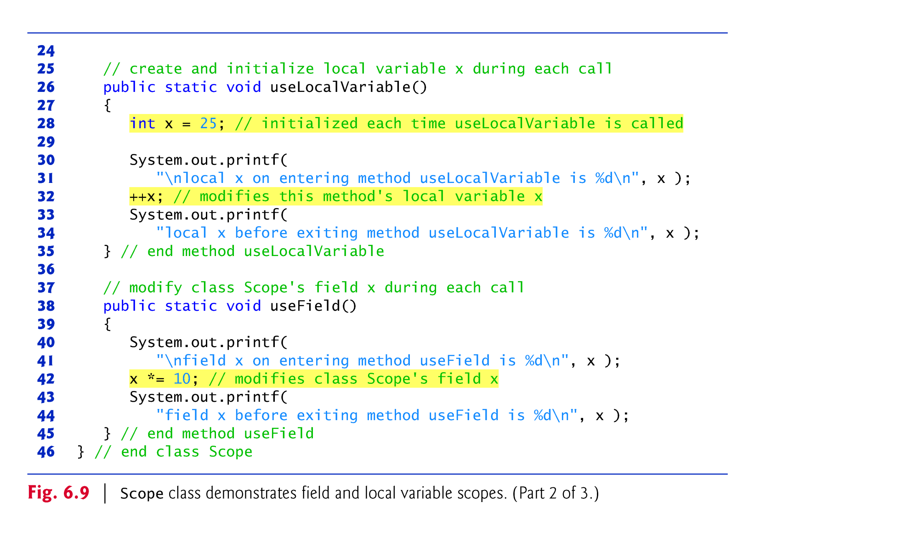

Slide 61
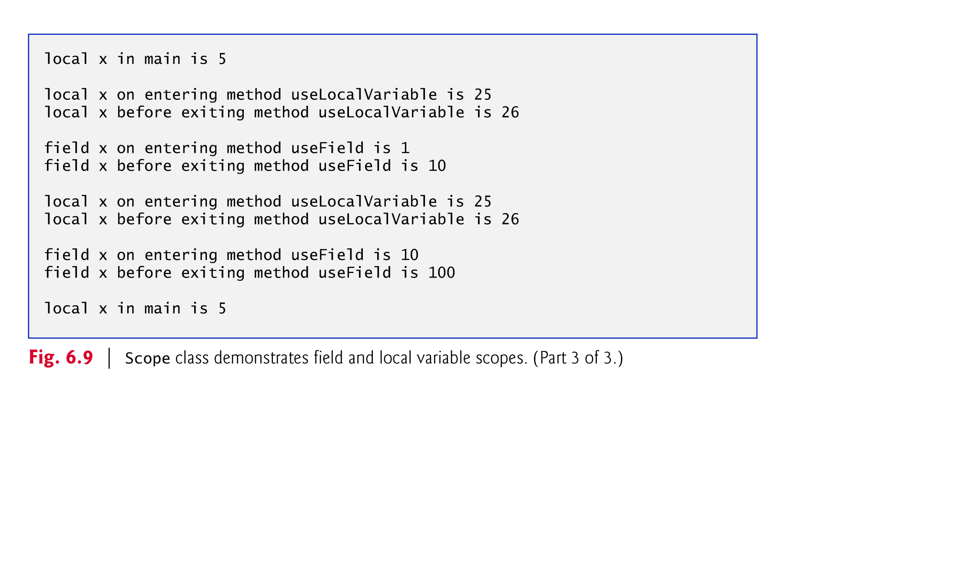

Slide 62
6.12 Method Overloading
Method overloading
Methods of the same name declared in the same class
Must have different sets of parameters
Compiler selects the appropriate method to call by examining the number, types and order of the arguments in the call.
Used to create several methods with the same name that perform the same or similar tasks, but on different types or different numbers of arguments.

Slide 63
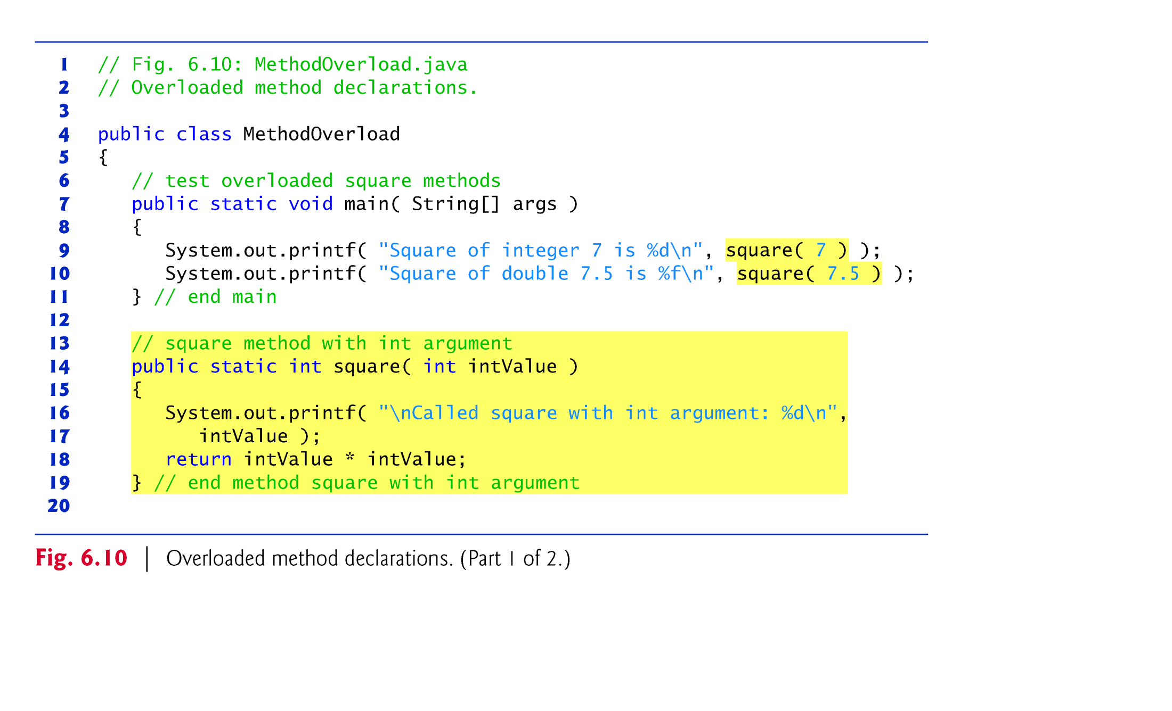

Slide 64
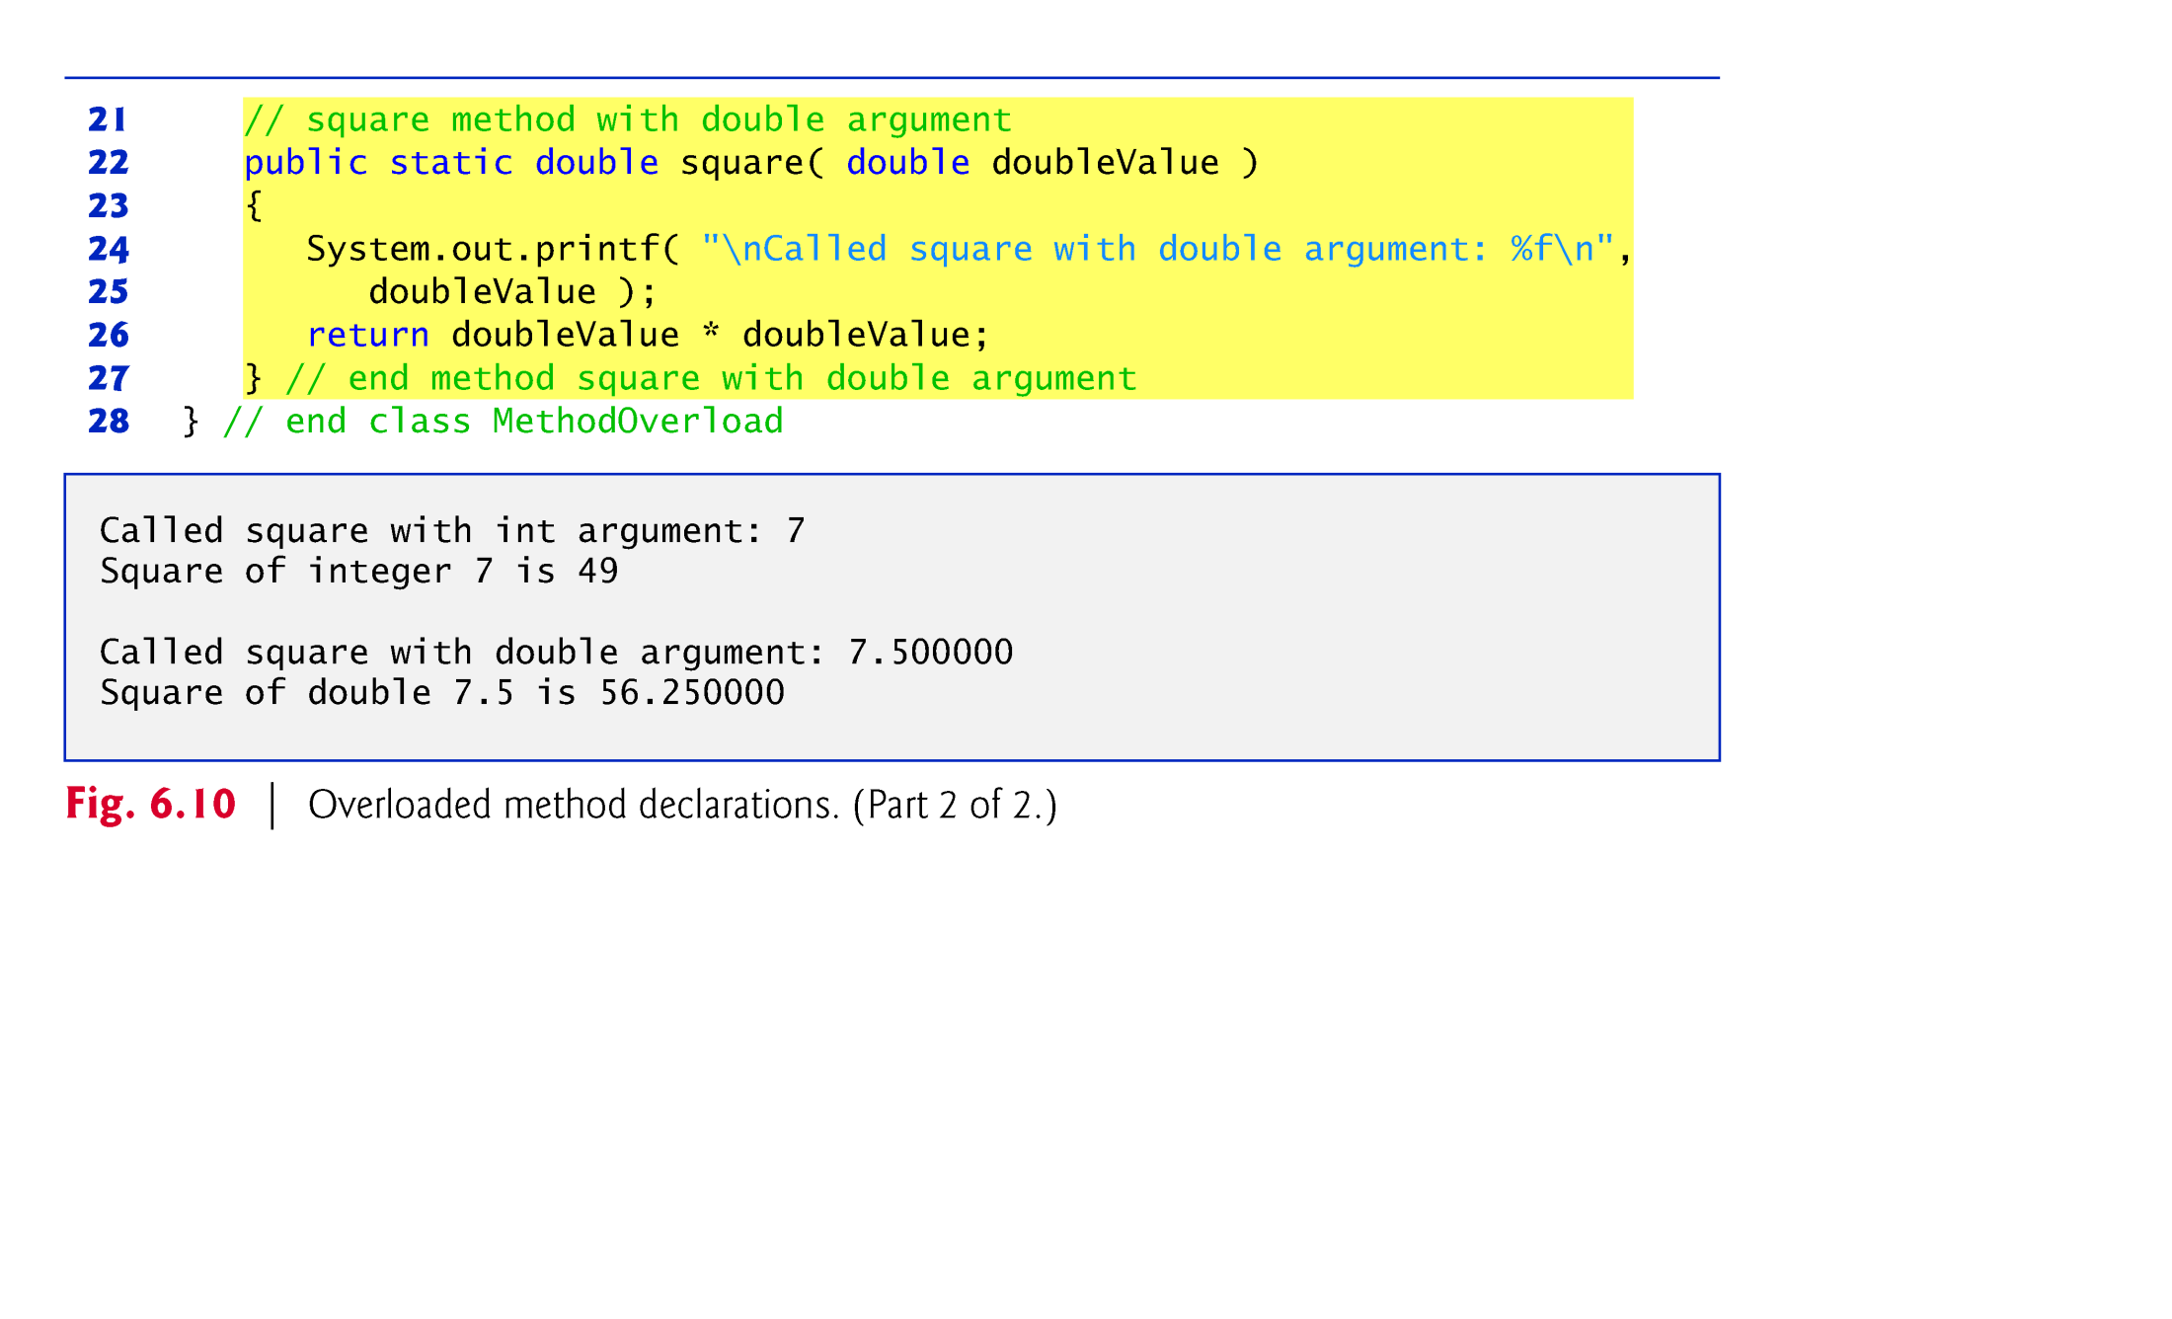

Slide 65
6.12 Method Overloading (cont.)
Distinguishing Between Overloaded Methods
The compiler distinguishes overloaded methods by their signatures—the methods’ names and the number, types and order of their parameters.
Return types of overloaded methods
Method calls cannot be distinguished by return type.

Slide 66
6.13 (Optional) GUI and Graphics Case Study: Colors and Filled Shapes
Colors displayed on computer screens are defined by their red, green, and blue components (called RGB values) that have integer values from 0 to 255.
The higher the value of a component color, the richer that shade will be in the final color.
Class Color (package javafx.scene.paint) represents colors using their RGB values.
class Color contains dozens of predefined static Color objects that each can be accessed via the class name and a dot (.), as in Color.RED.

Slide 67

6.13 (Optional) GUI and Graphics Case Study: Colors and Filled Shapes (Cont.)

Slide 68
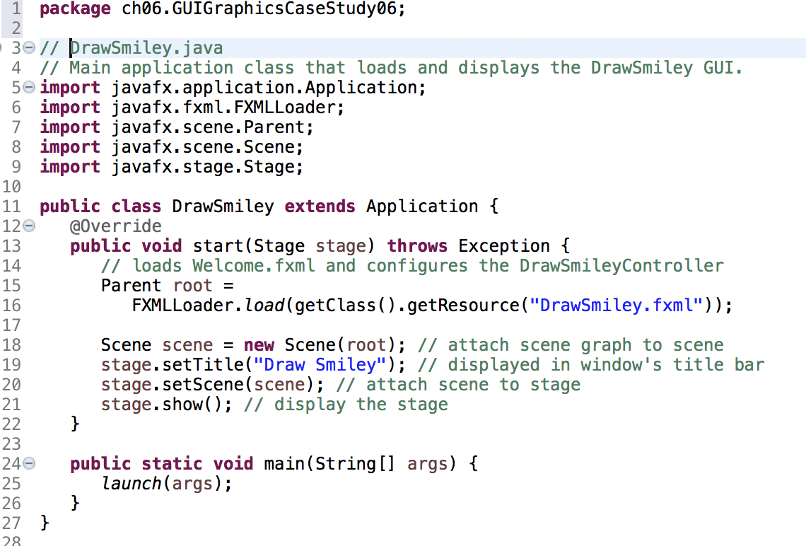

Slide 69
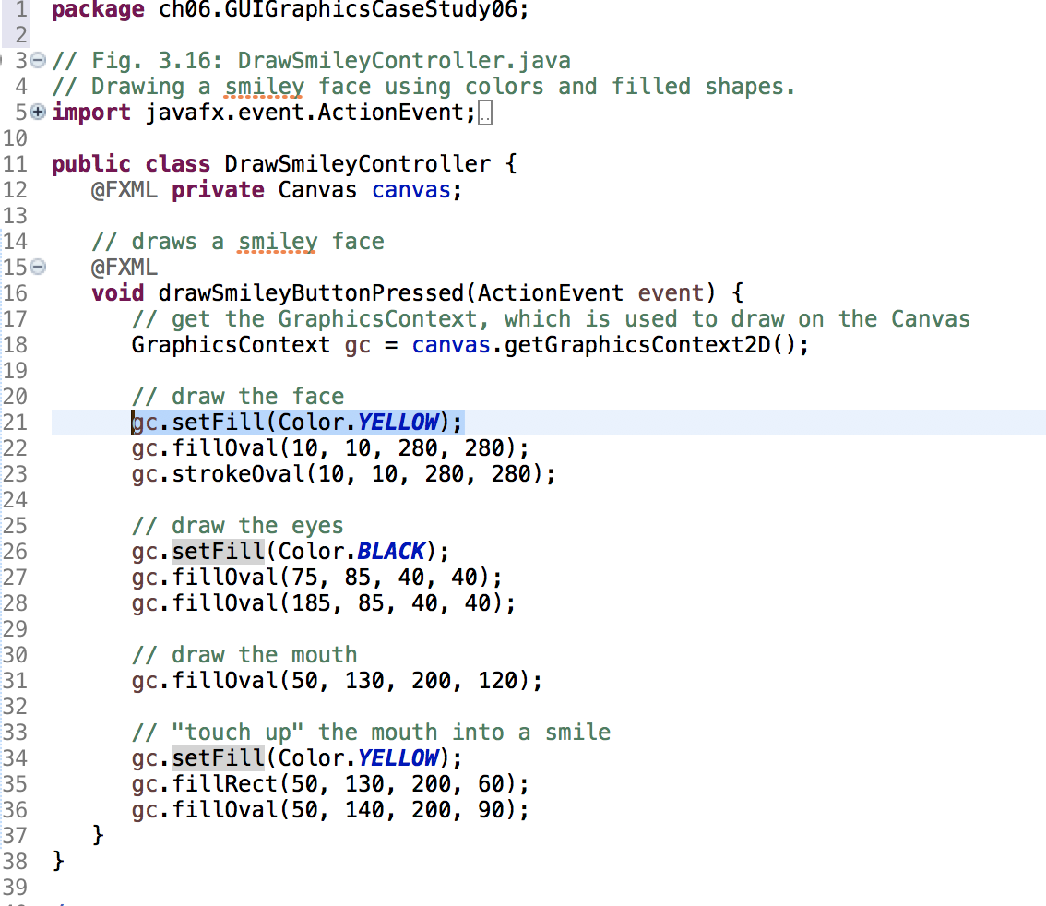

Slide 70
6.13 (Optional) GUI and Graphics Case Study: Colors and Filled Shapes(Cont.)
Method fillOval draws a circle.
Mehtod setStroke changes the stroke color.

